Slide 1
Robot ARM
Precision Remote Control
The Assembly Team

Slide 2
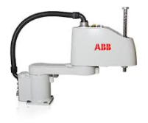
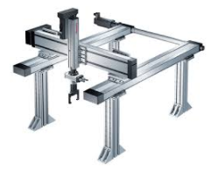
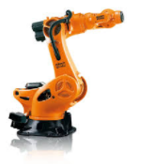
Background
Robot Arm
Programmable mechanical device with similar functions like human arm.
SCARA
Cartesian
Articulated

Slide 3
Degrees OF Freedom

Slide 4
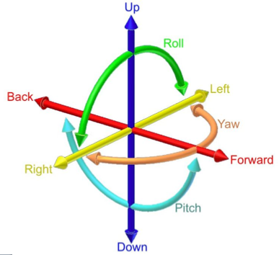
1
2

Slide 5
3
1
2
3
5
4
1
2
2
1
3

Slide 6
Electric MOTORS

Slide 7
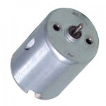
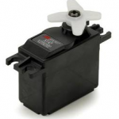
 | DC MOTOR | SERVO MOTOR
Speed | Higher | Lower
Poles | 3: + , - | 2: +, - , control
Position control | No | Yes
Rated by | RPM | Torque
Applications | electric car driver, drones, winches, rolling doors | remote steering/speed control, meter display, robots

Slide 8
MOTOR CONTROL

Slide 9
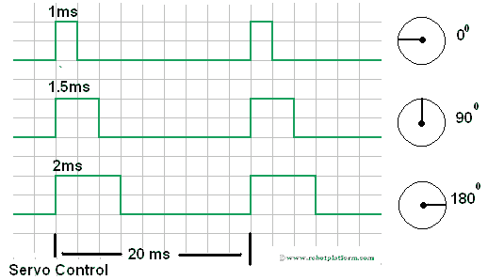

Slide 10
Motor Control (cont’d)

Slide 11

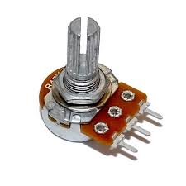
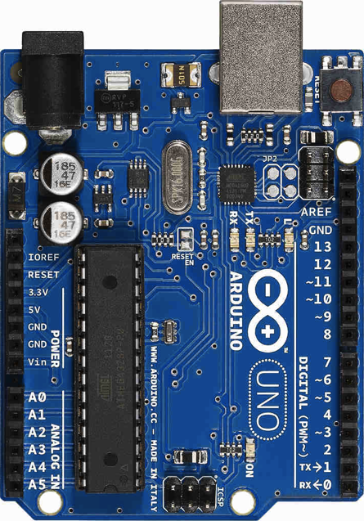
Position
Voltage
Pulse

Slide 12
Our Robot TODAY

Slide 13
4 Degrees of Freedom
C
D
B
A

Slide 14
Fritzing Diagram

Slide 15
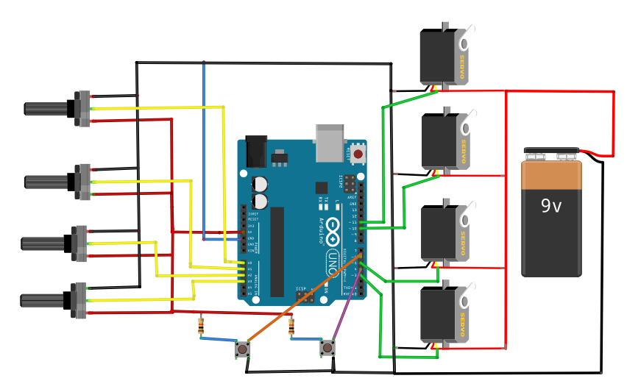
A
1
B
2
Motors
A to pin 11
B to pin 10
C to pin 5
D to pin 3
C
3
4
D
Potentiometers
Connect to A0 – A3

